Slide 1
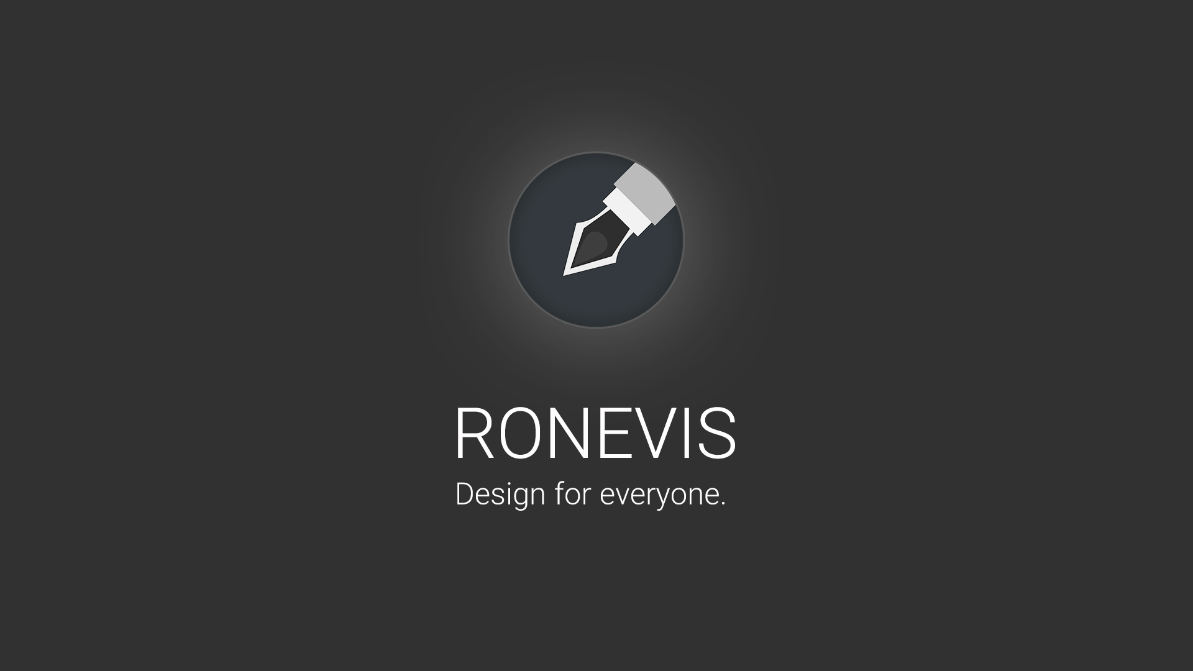

Slide 2
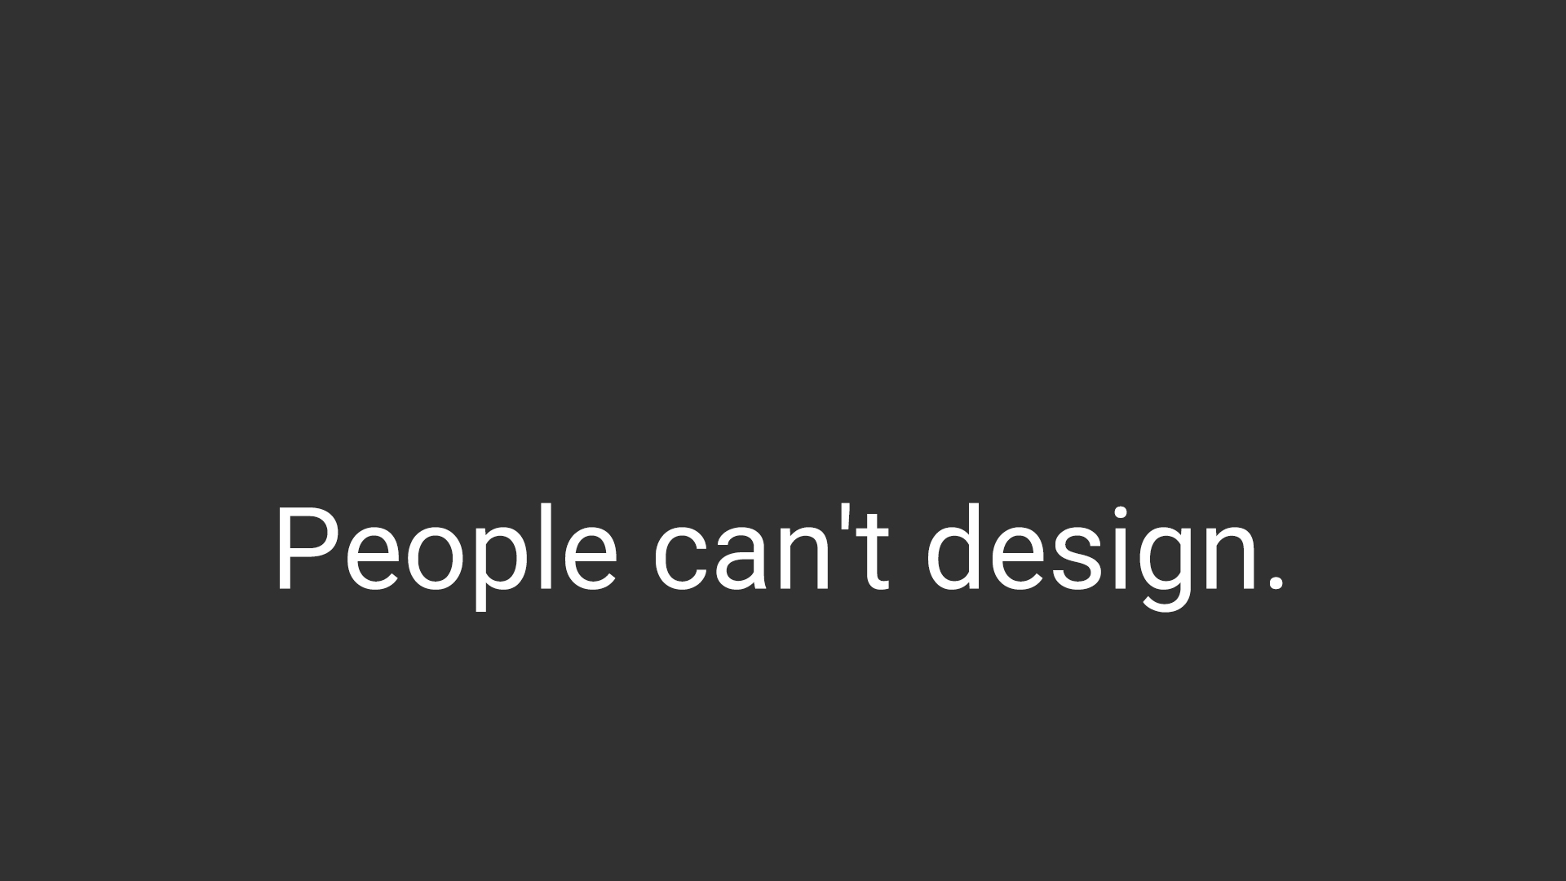
Notes:
90% of information transmitted to the brain is visual, and the problem is that the most people can't design what they want.

Slide 3
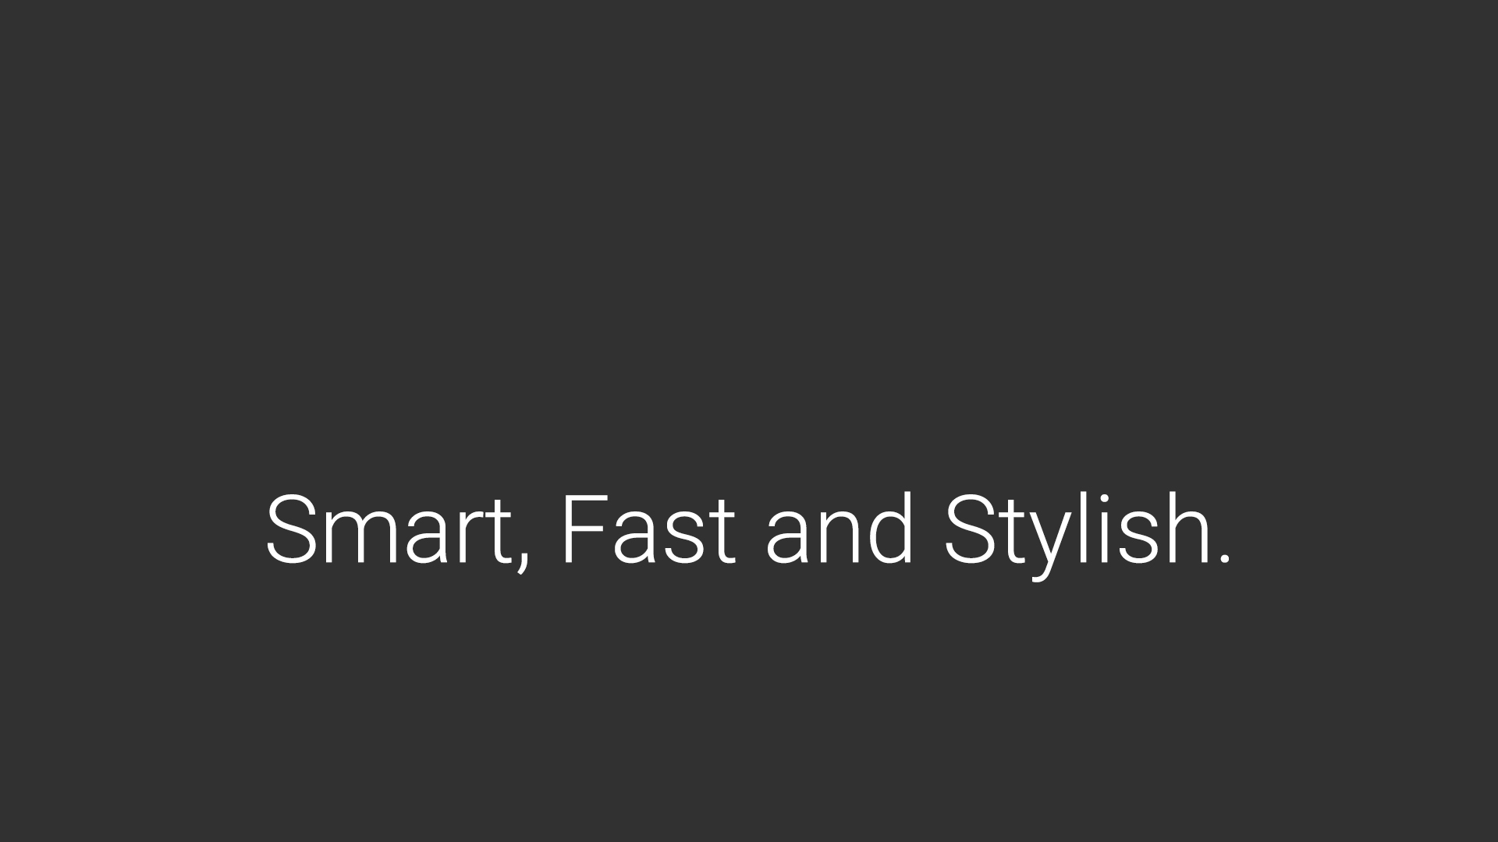
Notes:
by help of ronevis you can design what you want, smart, fast and stylish way.

Slide 4
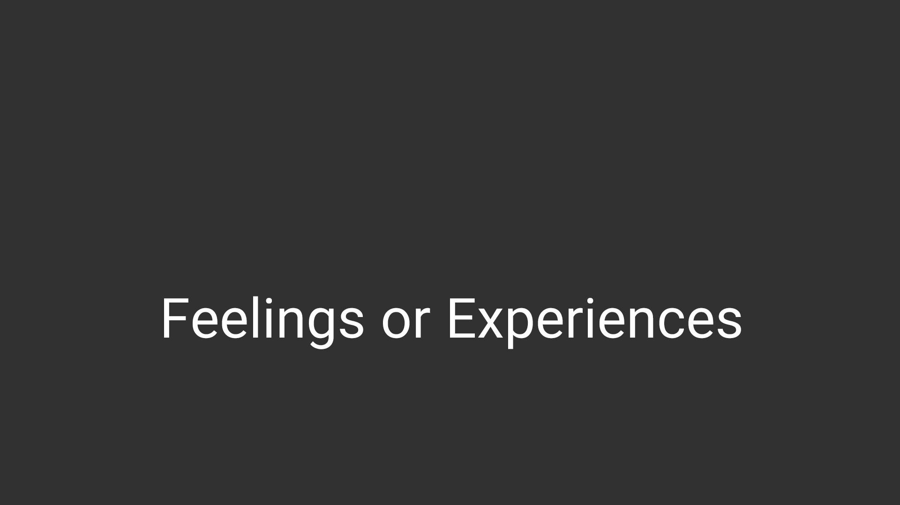
Notes:
everyone who has a smartphone can be our customer with the potential need of designing something expressing their feelings or experiences

Slide 5
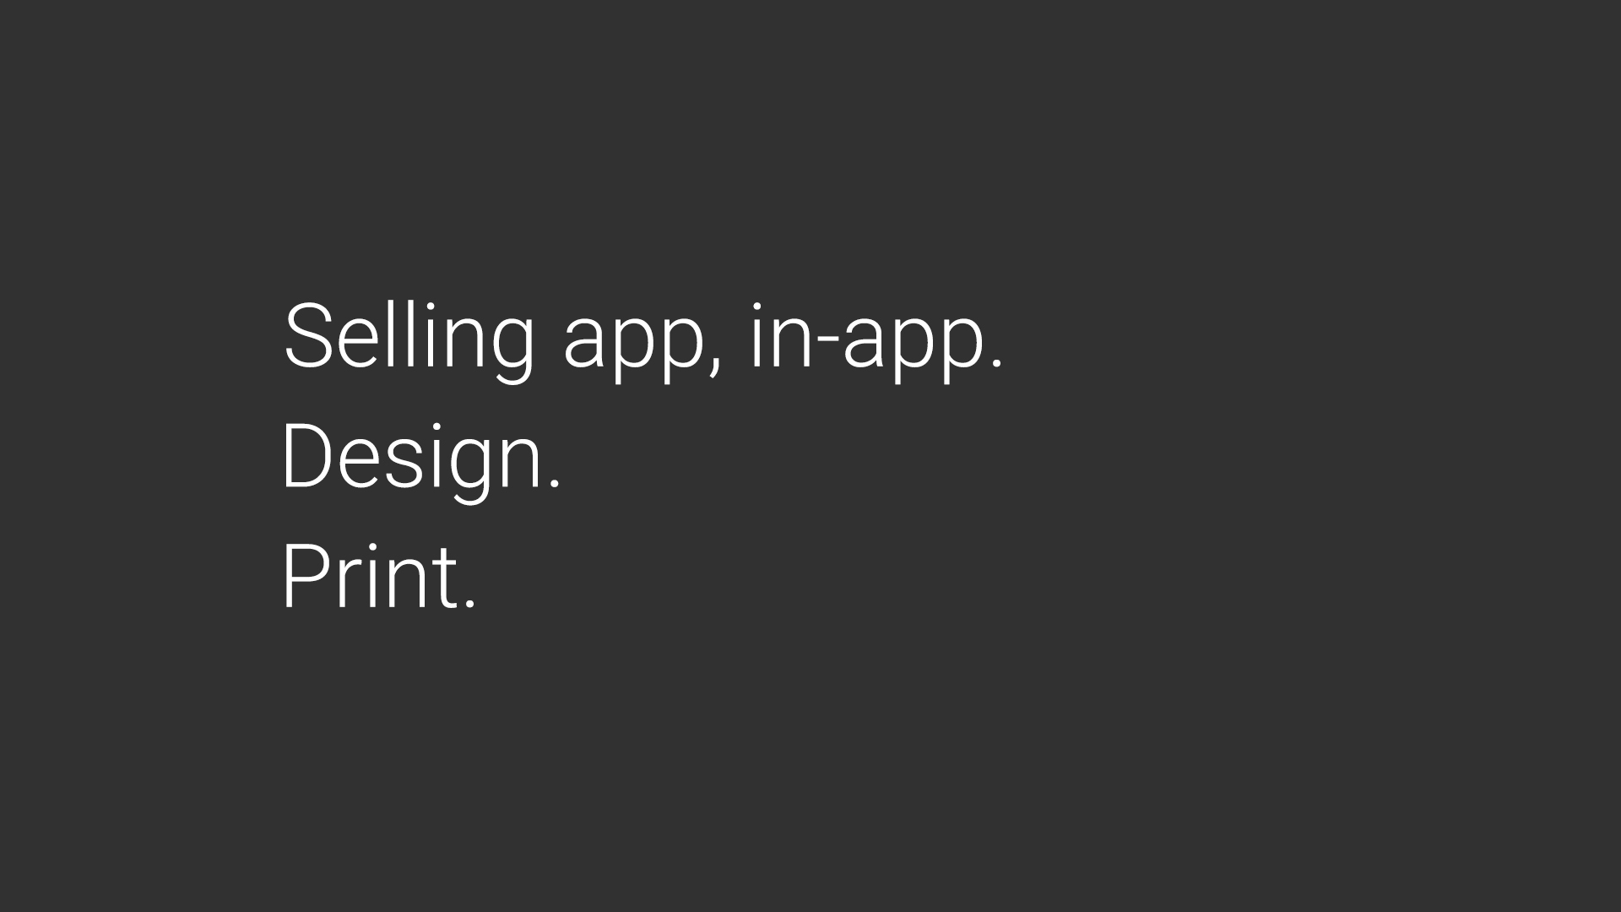
Notes:
our revenue stream is coming from selling app, in-app purchase packages,
printing services and design services

Slide 6
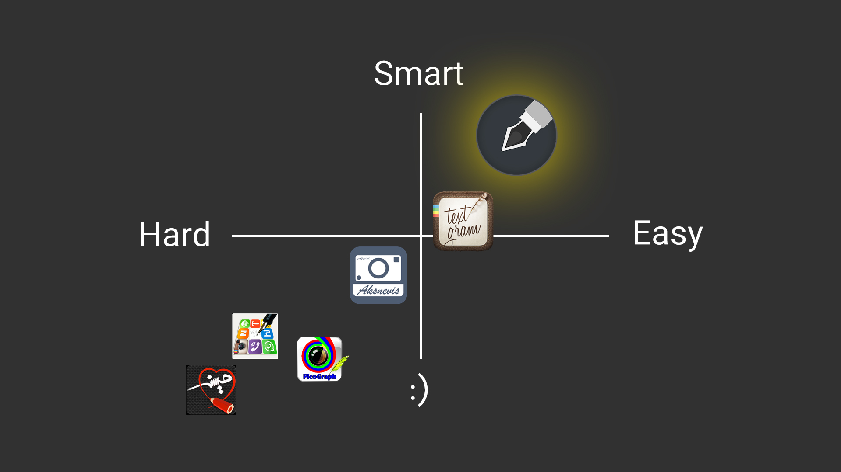
Notes:
and based on this perceptual map we do not have direct competitors.

Slide 7
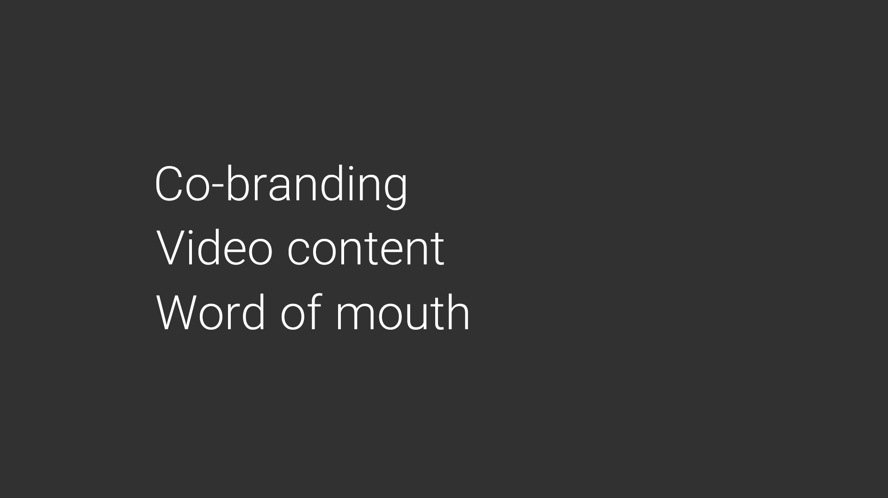
Notes:
our marketing plans include video content marketing, word of mouth, android market places, social networks and co-branding with companies that are related to us.

Slide 8
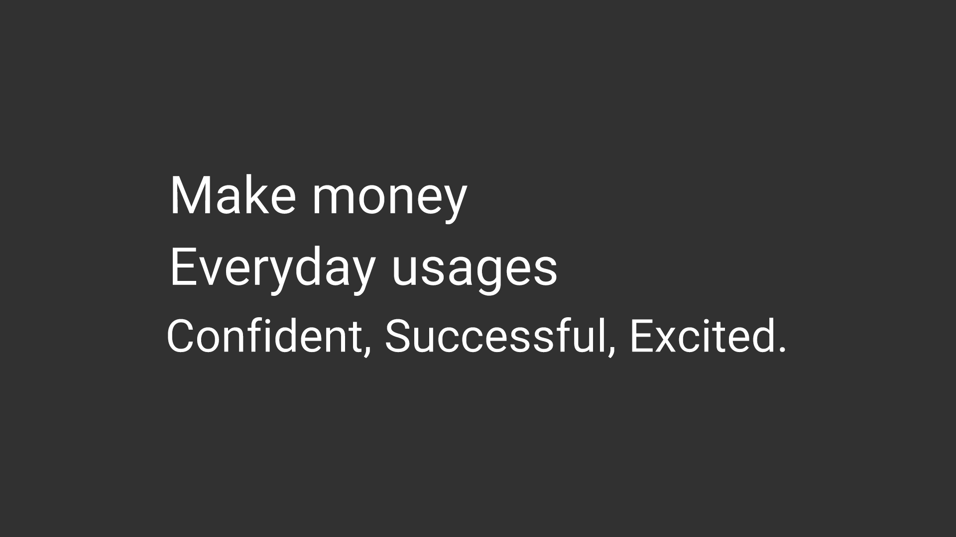
Notes:
the value people can gain from this app is that they can make money by designing instagram pages or telegram channels.
everyday usages like sending a greeting card to a friend or family.
people can feel more confident, successful, and excited.

Slide 9
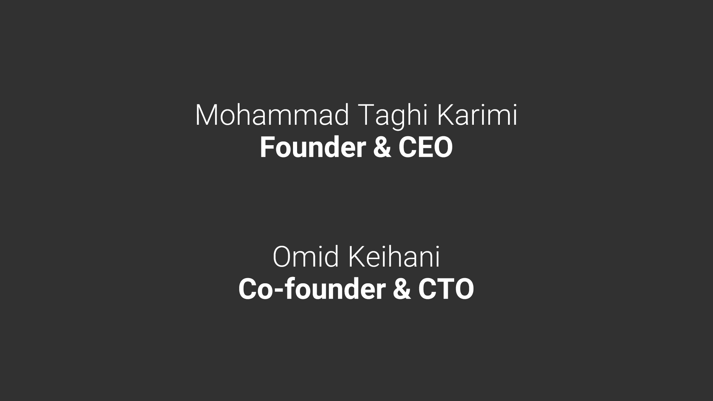
Notes:
this is me mohammad taghi karimi founder and ceo
and this is omid keihani co-founder and cto of ronevis.
we have been friends for more than 10 years

Slide 10
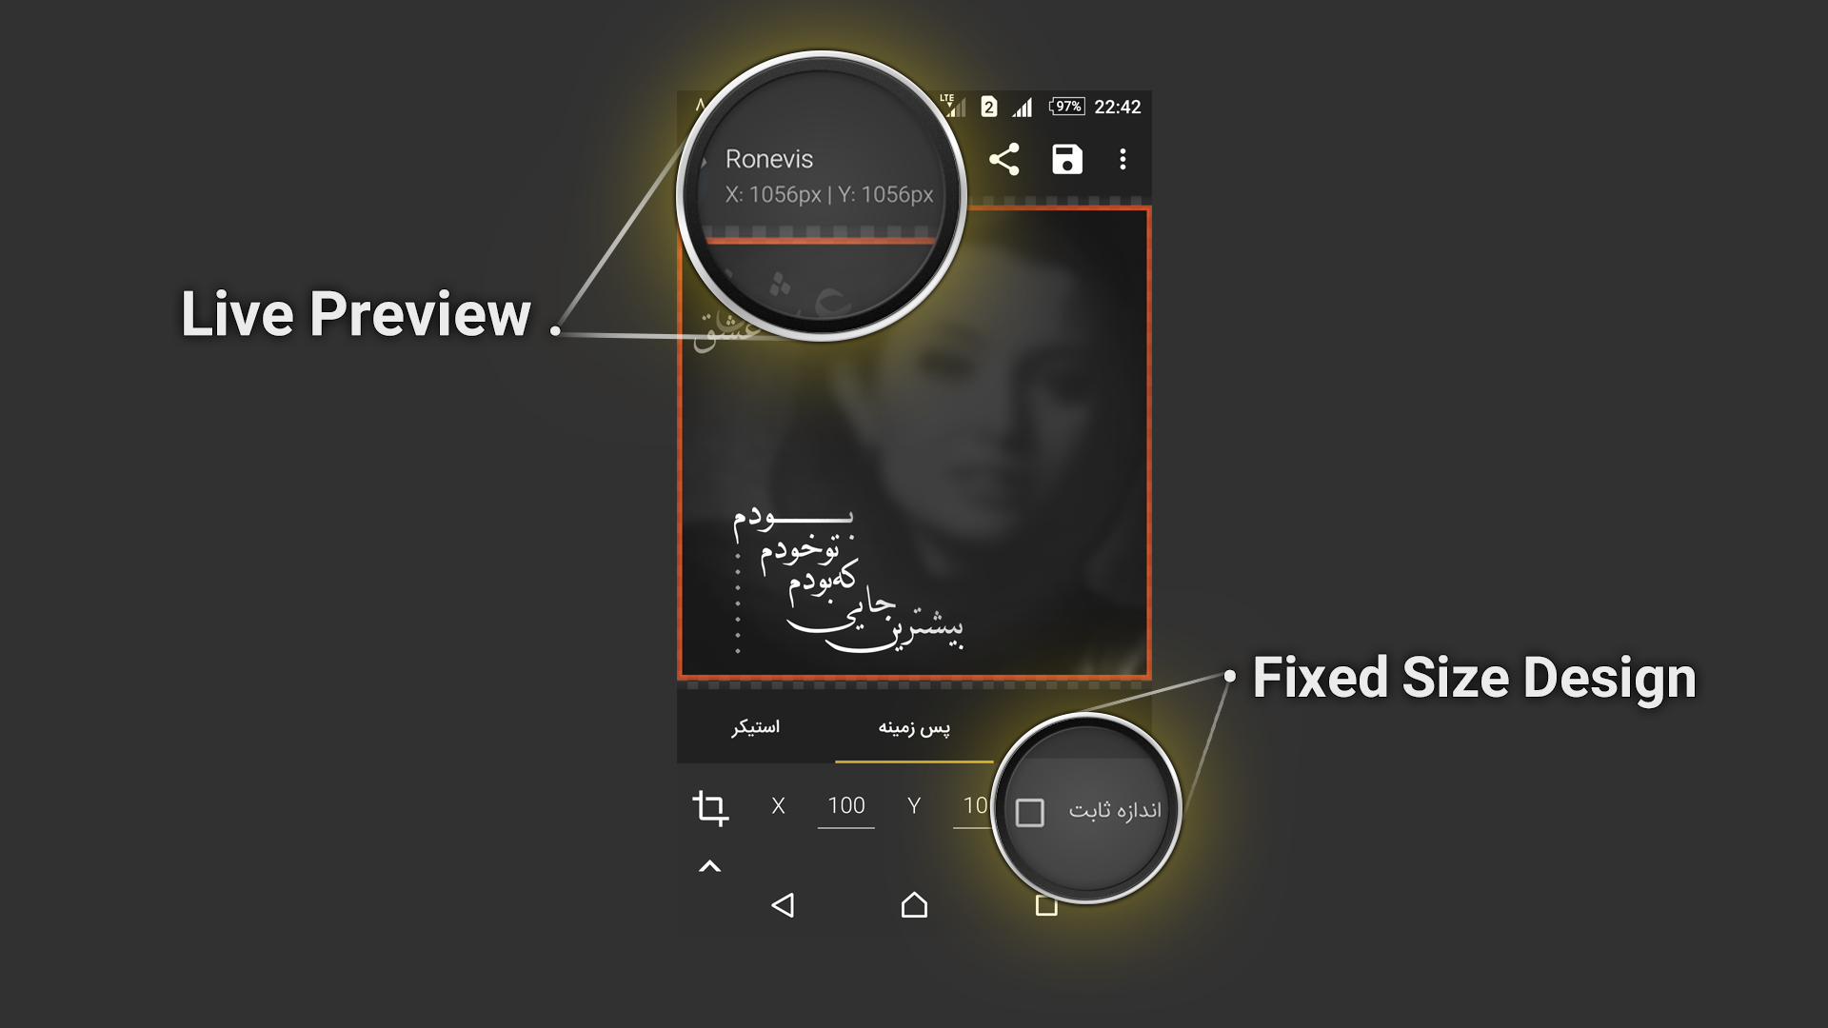

Slide 11
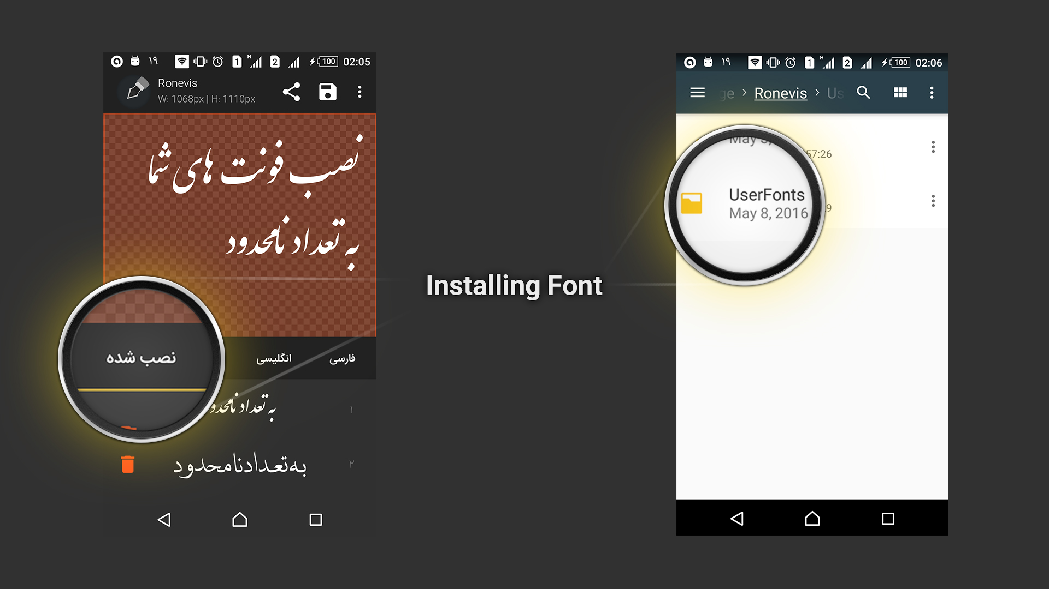

Slide 12
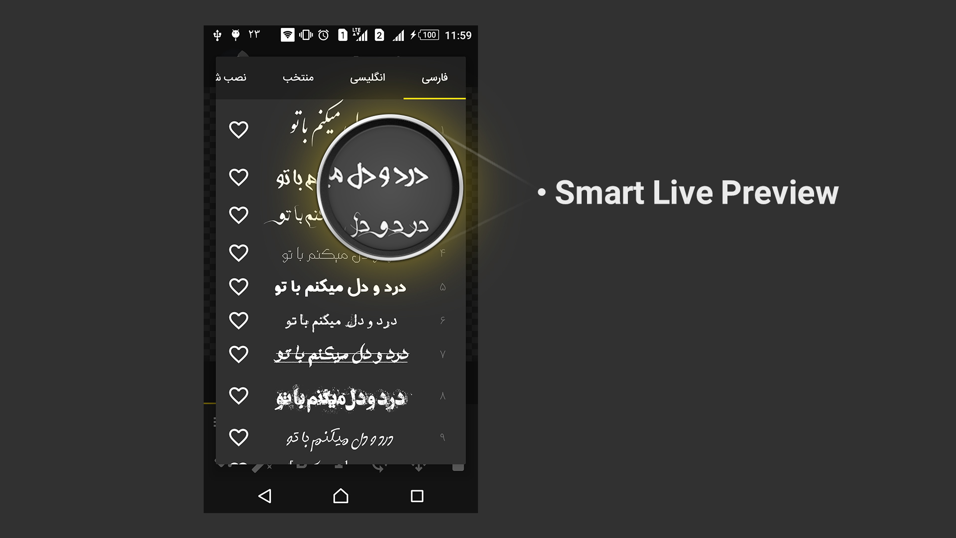

Slide 13
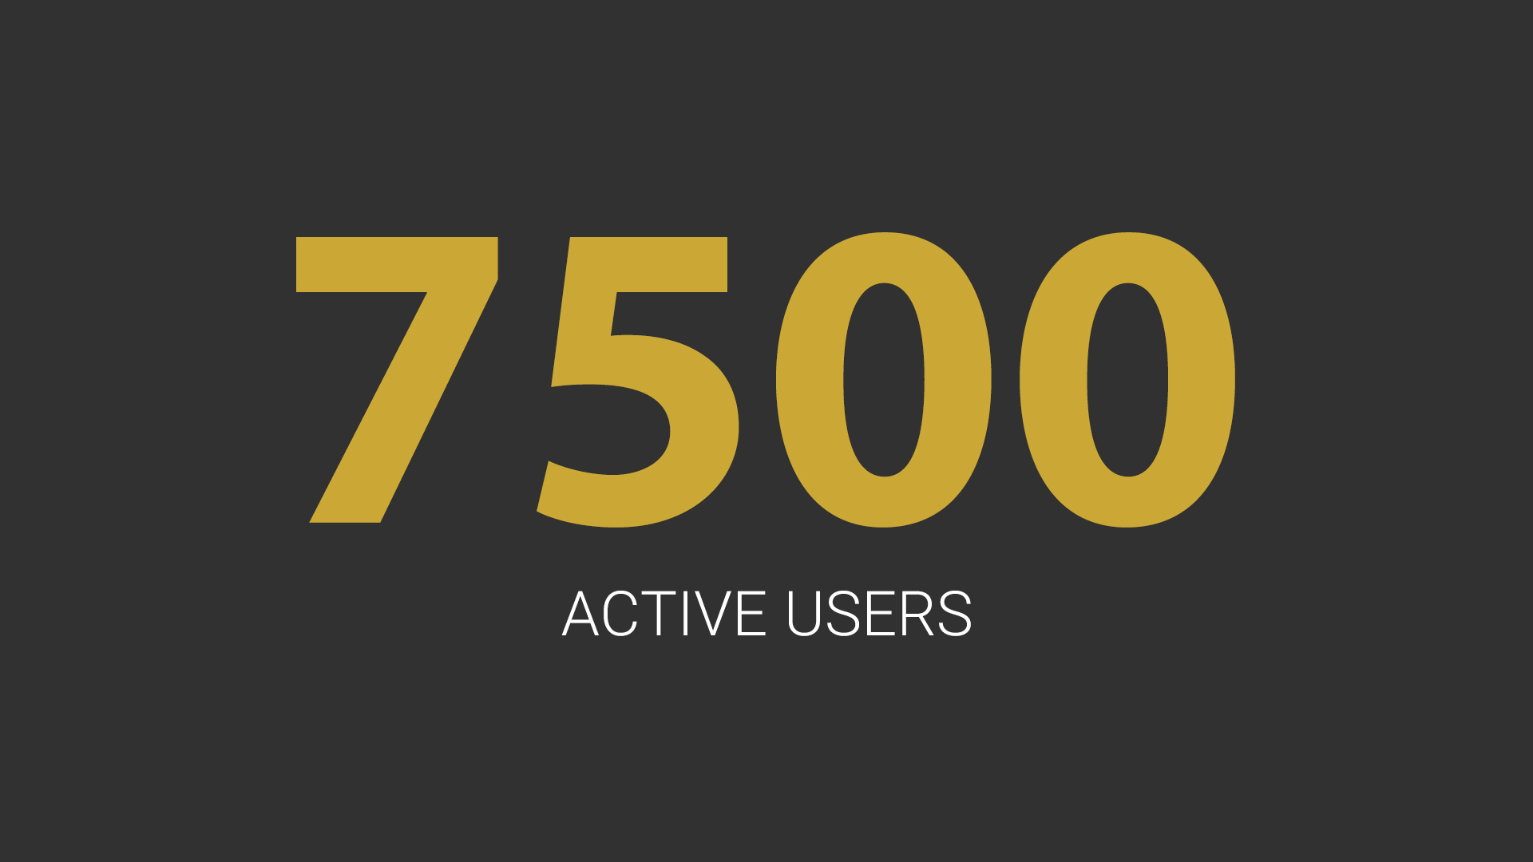
Notes:
We have 7 thousand 500 hundred active users

Slide 14
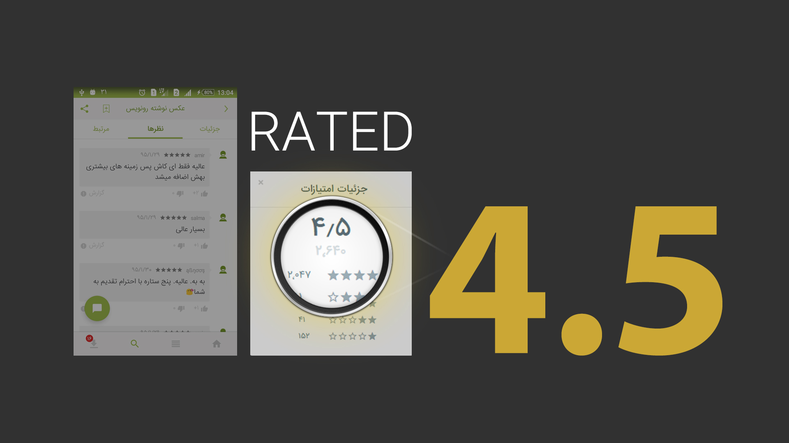
Notes:
We are rated 4.5 from 2 thousand 640

Slide 15
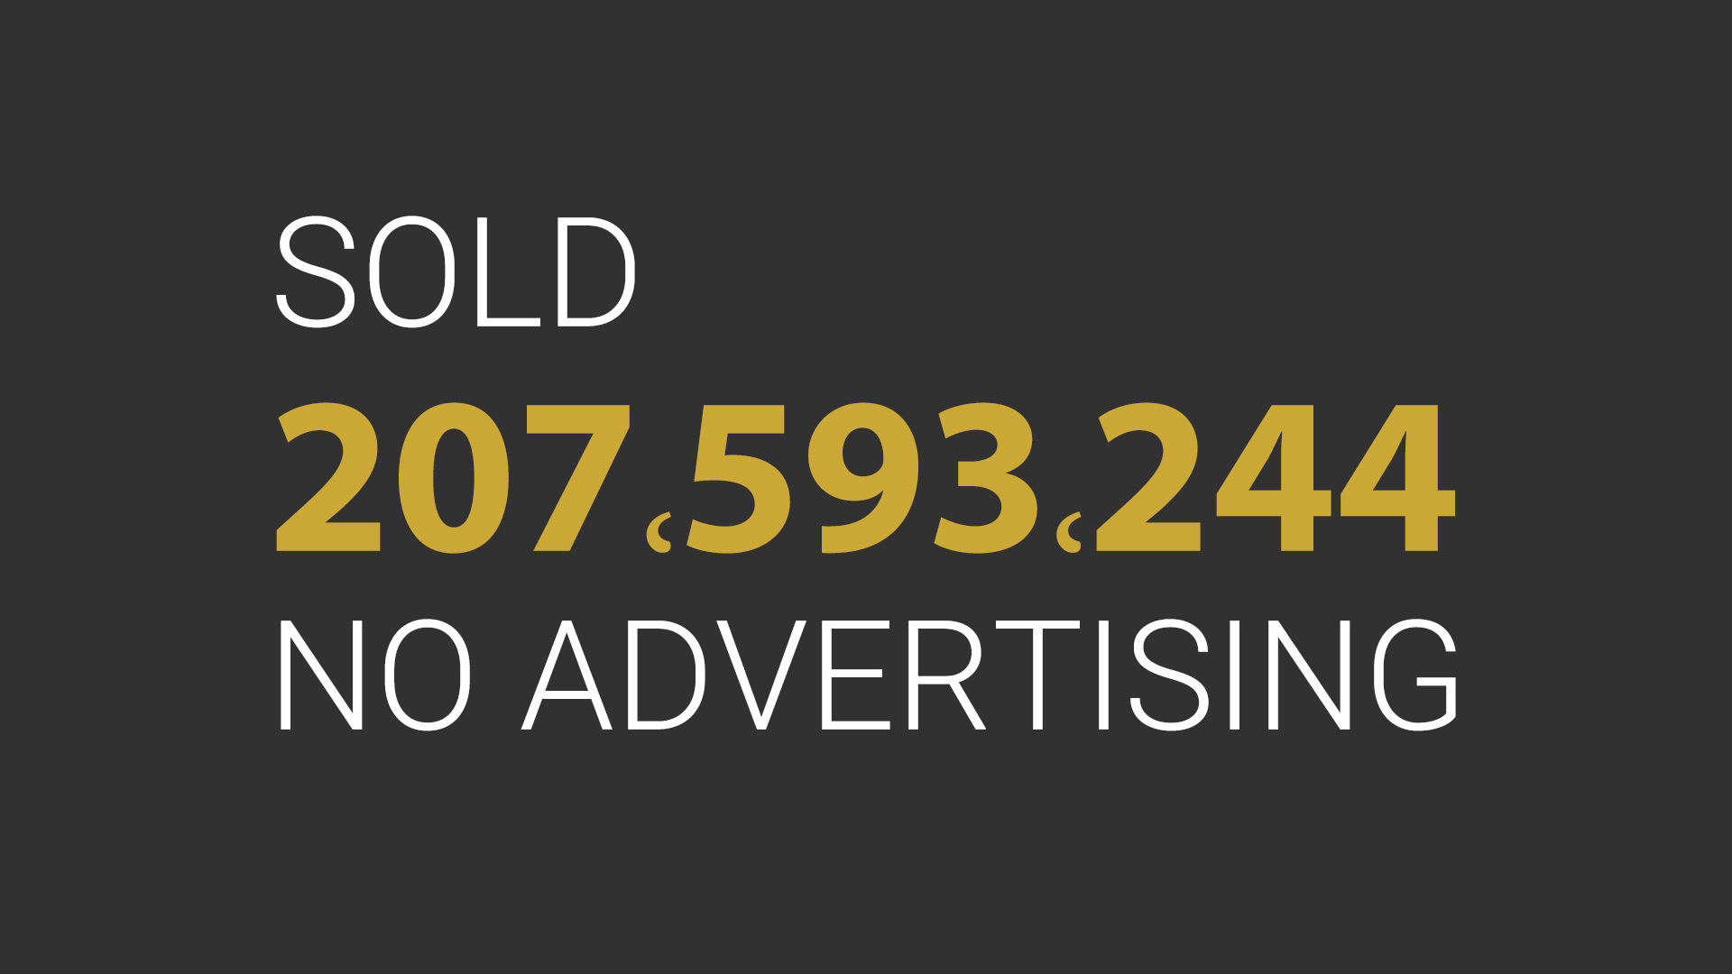
Notes:
We sold more than 20 million toman without advertisment

Slide 16

Notes:
At the moment we are the market leader based on our price, quality, and users.

Slide 17
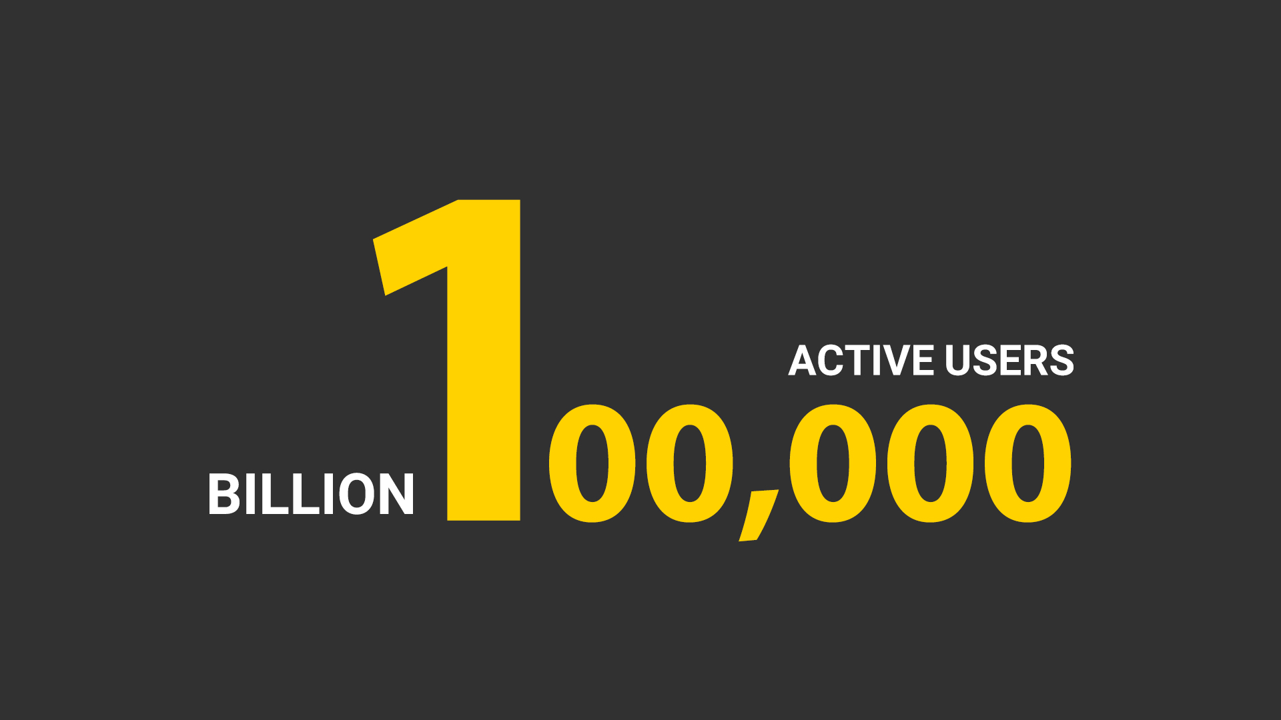
Notes:
And as you can see this is our vision for the next year
Having one hundred thousand active users 100,000
And selling around one billion toman

Slide 18
Notes:
Thanks a lot for your time

